Slide 1

Public Transportation Efficiency Analysis
In this presentation, we dive into the world of Australian public transportation with a focus on Adelaide City buses. We will walk you through the data visualization, data loading, preprocessing and cleansing process of the project. Get ready for insights that will surprise you!

Slide 2
Index
1
Introduction to Jupyter Notebook and Visualization
2
Data Processing Techniques with Snapshots of Code
3
About IBM Cognos and Some Visualizations performed
4
Conclusion

Slide 3

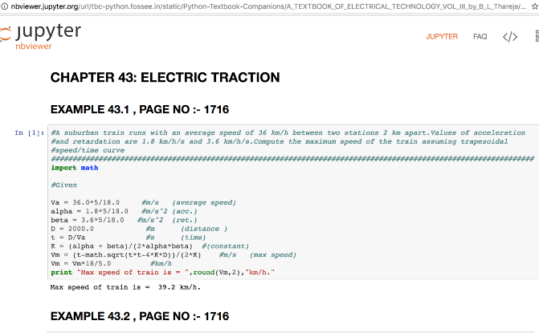
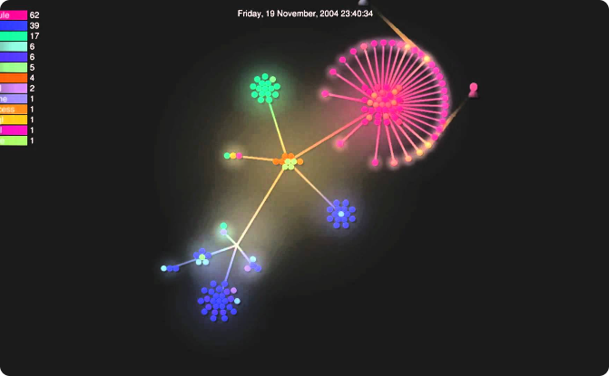
Jupyter Notebook and Visualization
Anaconda's Jupyter Notebook
IBM Cognos Visualization
Our analysis was conducted in a Jupyter Notebook environment, which allowed us to interact with the data in real-time and visually present our findings.
We used Python libraries to develop custom visualizations of the data that helped us present our findings in a clear, concise, and engaging way.

Slide 4


Data Processing: Unleashing the Power of Cleaned Data
Streamlined Processing
Data Manipulation
Advanced Analytics

Slide 5
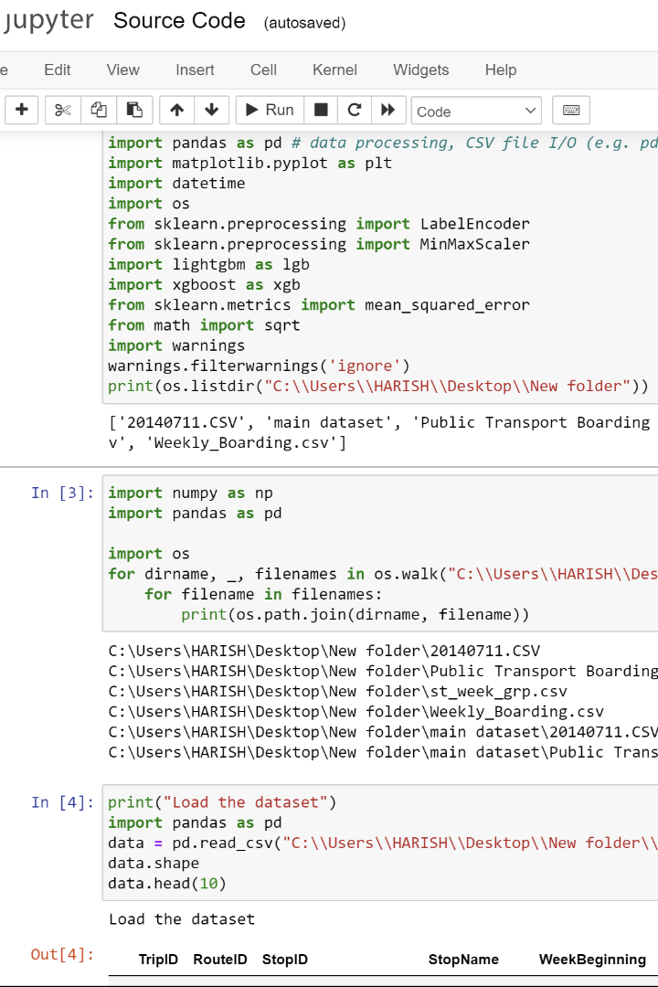
Streamlined Processing
Streamlined processing in data cleaning within a Jupyter Notebook is a critical aspect of data analysis and preparation. Jupyter Notebook is an open-source, interactive environment that combines code, documentation, and visualizations, making it a popular choice for data scientists and analysts. To streamline data cleaning, several key steps should be followed. First, data should be imported into the notebook, typically using libraries like Pandas. Data profiling is essential to understand its structure and identify issues such as missing values, outliers, and inconsistent data types. Once identified, missing values can be handled through imputation or removal, while outliers might require further investigation.

Slide 6
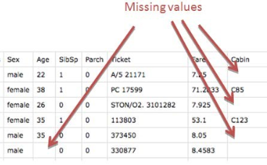
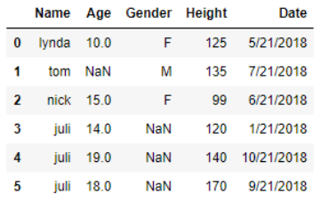
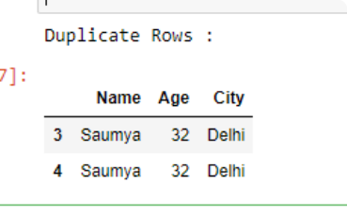
Blank Spaces
Null values
Duplicate values
Blank spaces, or missing values, in a dataset are a common challenge in data analysis. These empty or undefined data points can arise for various reasons, including data entry errors, equipment malfunctions, or simply because certain information wasn't collected.
Null values, often represented as "NaN" (Not-a-Number) in datasets, are a common issue in data analysis. These missing values can arise due to various reasons, such as data entry errors, sensor malfunctions, or simply the absence of information.
Duplicate values in a dataset are identical records that appear more than once. These duplicates can introduce errors and bias into data analysis, leading to inaccurate results and misleading insights.
Identifying and handling duplicates is a crucial step in data cleaning. Duplicates can occur for various reasons, such as data entry errors, system glitches, or merging datasets.
Dealing with missing values is crucial for accurate and meaningful analysis.data cleaning should be a dynamic process with regular checks and iterations.
Dealing with null values is crucial because they can significantly impact the accuracy and reliability of any analysis or model built on the dataset.

Slide 7

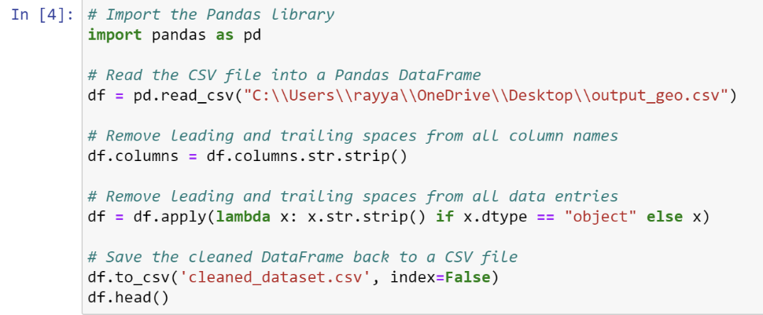
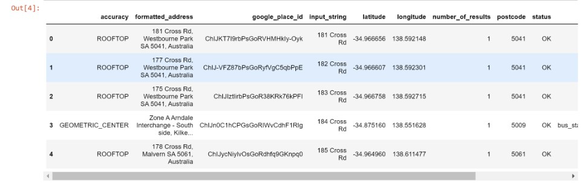
Code for Blank space removal
Removing blank spaces in a CSV dataset using Python can significantly enhance data quality and consistency. Extraneous white spaces can lead to issues when working with data, including difficulties in filtering and matching records. To address this problem, Python provides several methods and libraries, with Pandas being a popular choice. Here's a brief overview of how to remove blank spaces from a CSV dataset using Python and Pandas —>

Slide 8

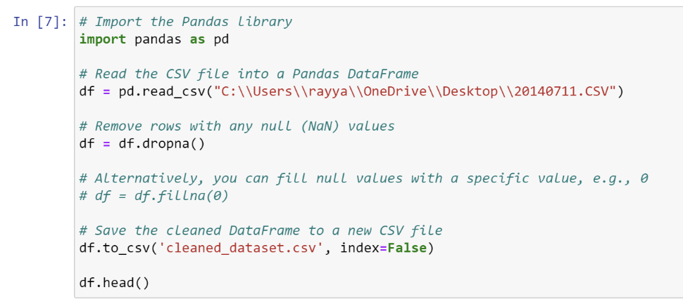
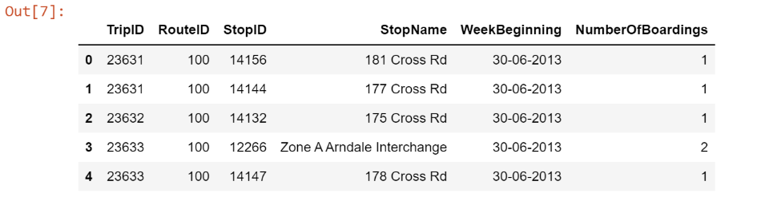
Code for Null values(NaN) Removal
Dealing with null values in a CSV dataset is a critical step in data cleaning to ensure the quality and reliability of your data. Python, with the help of the Pandas library, offers a convenient way to handle these missing values. Here's an overview of how to remove null values from a CSV dataset using Python—>>
Loading...

Slide 9

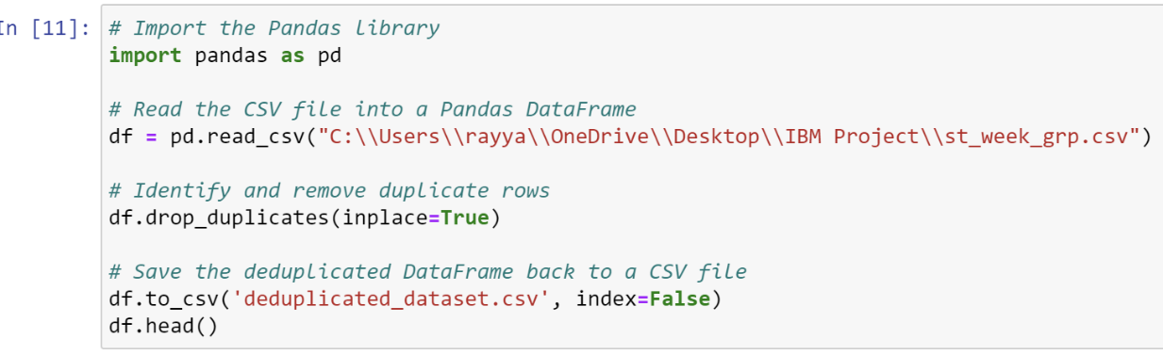
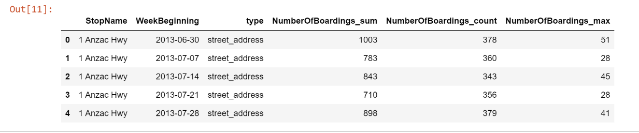
Code for removal of Duplicate Values
Eliminating duplicate values from a CSV dataset using Python is a fundamental data cleaning task, ensuring data accuracy and integrity. Python's Pandas library offers a powerful and straightforward solution for this. Here's a concise overview of how to remove duplicates in a CSV dataset—>>

Slide 10
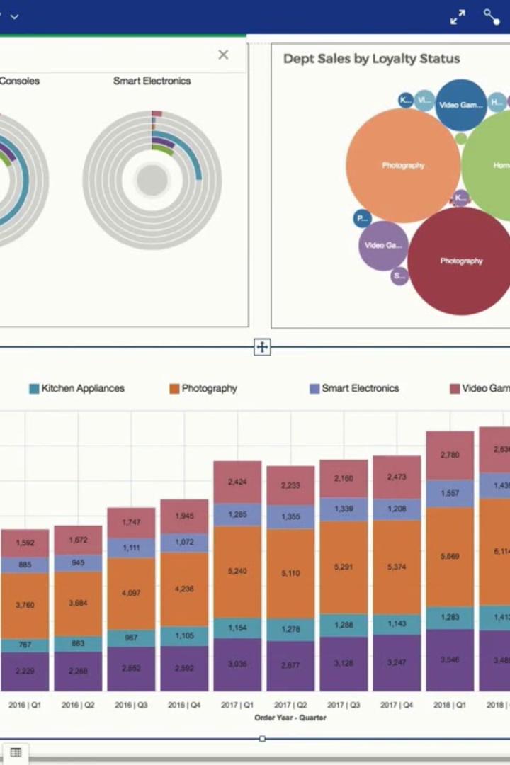
About IBM Cognos
Visualizing data is an art and a science that allows us to transform raw numbers and statistics into compelling, actionable insights. It's like turning a dusty old tales into a captivating storybook.
In our experience, IBM Cognos is a powerhouse for data visualization. It offers a versatile set of tools and features that empower us to bring data to life, making it easier to understand, analyze, and share with others. Whether you're a seasoned data analyst or just dipping your toes into the world of business intelligence, IBM Cognos has something to offer.
With this tool, we can create visually stunning charts, graphs, and dashboards that not only look impressive but also convey complex information with utmost clarity. Whether it's for making critical business decisions or simply for telling a persuasive story to stakeholders, IBM Cognos is the key to unlocking the full potential of your data.
In this presentation, we have visualised some of the head columns with each other in the two datasets that have been provided to us.

Slide 11
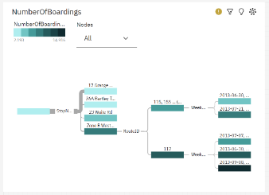
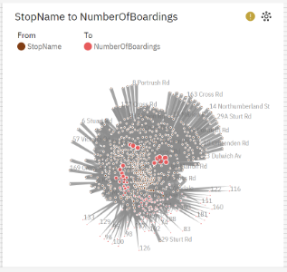
Visualization by Number of Boardings
Details:
This visualization illustrates the number of boardings at various stops along a specific route. Understanding the passenger activity at different stops is crucial for optimizing public transportation services.
The number of boardings may vary seasonally, with more passengers during certain months or events.Preparing for seasonal fluctuations is vital for providing consistent and reliable service.
Insights:
The data reveals notable variations in the number of boardings at different stops. Stop A stands out as a major transportation hub with the highest ridership, possibly serving as a crucial transfer point for multiple routes.
Meanwhile, Stop B, though slightly less busy than Stop A, still experiences significant passenger activity, indicating its significance as an origin or destination point.

Slide 12
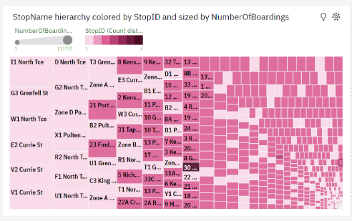
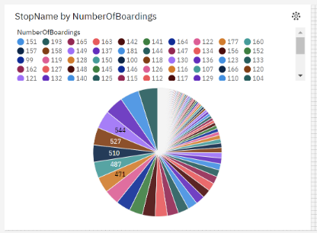
Visualization by StopName
Deatils:
Insights:
To better understand the public transportation system's efficiency and ridership across different stops, we've examined two key datasets. The first dataset, which focuses on ridership, highlights the number of boardings at each stop.
In the ridership dataset, stopid serves as a unique identifier for each stop, while stop name provides the corresponding stop's name.
The correlation between these two columns can help identify which stops are most popular in terms of daily boardings and subsequently draw attention to key areas of transportation demand.The efficiency dataset, on the other hand, uses a similar structure with stopid and stop name.
The second dataset centers on efficiency metrics, including stop-specific data. Visualizing the relationship between stopid and stop name in these datasets can reveal compelling trends and patterns.

Slide 13
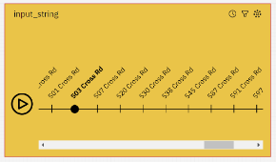
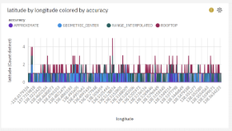
Visualization by InputString
Input String vs. Stop Name in Ridership Dataset:
The connection between stop name and input string enables data-driven decision-making, allowing transit authorities to identify areas that may require adjustments, increased service frequency, or other enhancements for better passenger experience.
User-Friendly Search: The presence of an input string in the ridership dataset indicates user friendliness.
Visualization by Latitude and Longitude
Ridership Dataset - Accuracy, Latitude, and Longitude:
In both datasets, the inclusion of latitude and longitude coordinates underscores the importance of geospatial information in public transportation. The accuracy of this information is vital for location-based services, route planning, and service optimization. It enables both passengers and transportation authorities to make informed decisions.
Geospatial Information: The inclusion of latitude and longitude in the ridership dataset indicates the availability of precise geospatial data for each stop. This data is valuable for mapping and location-based services, enabling passengers to find stops accurately.
The level of accuracy in latitude and longitude coordinates is a critical factor. High-quality data can lead to more efficient services, while inaccuracies can result in confusion and delays.

Slide 14
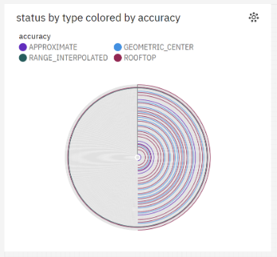
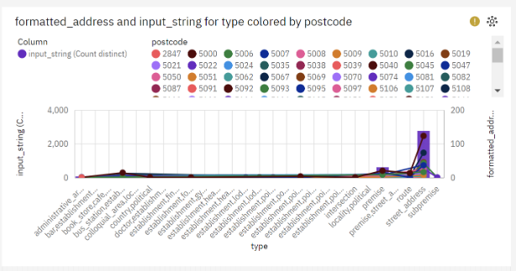
Visualization by Formatted Address
Ridership Dataset - Formatted Address and Postcode:
In both datasets, the incorporation of formatted address and postcode emphasizes the importance of standardized and descriptive location data. This information benefits passengers by providing clear stop descriptions and aids transportation authorities in assessing and improving the efficiency of their services. It also contributes to overall data quality and reliability.
Location Description: The inclusion of formatted address indicates a focus on providing passengers with clear and descriptive location information for each stop. Passengers can easily identify the stops they need to use, enhancing their overall experience

Slide 15
Conclusion
Our analysis of Adelaide City buses has revealed eye-opening insights into the performance, efficiency, and passenger experience of the transportation system. Our results will guide future improvements and modifications to make bus travel in Adelaide more efficient, convenient, and comfortable for all.

Slide 16
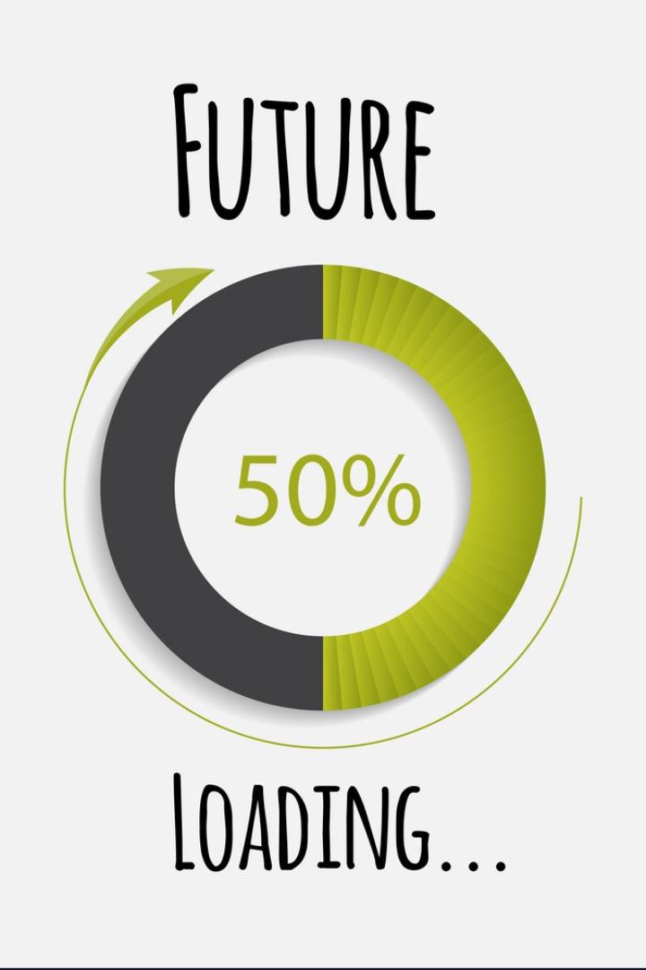
Further Analysis, In Phase 4
In phase 4, we will explore more detailed analyses on the impact of bus routes on the environment, safety of passenger, sentiment analysis through passenger feedback and more in-depth analysis of demographics and social-economic data.

